Slide 1


Hire Hub – Smart Recruitment & Job Portal for Campus and Companies
CSA1007-SOFTWARE ENGINEERING
DONE BY:
J.K.RISHIK(192511052)
R.JEEVAN(192524007)
C.H.NAVEENKUMAR(192425151)
M.MADHUSUDHAN-192425303
GUIEDE BY:
P.SUBRAMANIAN P

Slide 2


ABSTRACT
This project aims to develop a smart recruitment platform that connects students, colleges, and companies through a single system.
Module 1 focuses on student management, allowing students to create profiles, search for jobs, and apply for suitable opportunities.
Module 2 focuses on company management, allowing companies to post job openings, view applicants, and manage recruitment activities.
Module 3 and Module 4 manage placement activities and system administration to make the recruitment process organized, efficient, and easy to manage.

Slide 3
PROBLEM STATEMENT
1.Campus recruitment is difficult to manage when student, company, job, and application details are handled through different platforms.
2.Students and companies need a simple system to manage job applications and recruitment activities efficiently.
3.Here is a need for a centralized platform that connects students, colleges, and companies and simplifies the recruitment process.

Slide 4

INTRODUCTION
HireHub is a smart recruitment platform that connects students, colleges, and companies to simplify the campus recruitment process.
The system manages student profiles, job openings, applications, and placement activities in one centralized platform.
The platform helps students find suitable job opportunities, allows companies to manage candidates, and enables placement officers to monitor recruitment activities efficiently.

Slide 5
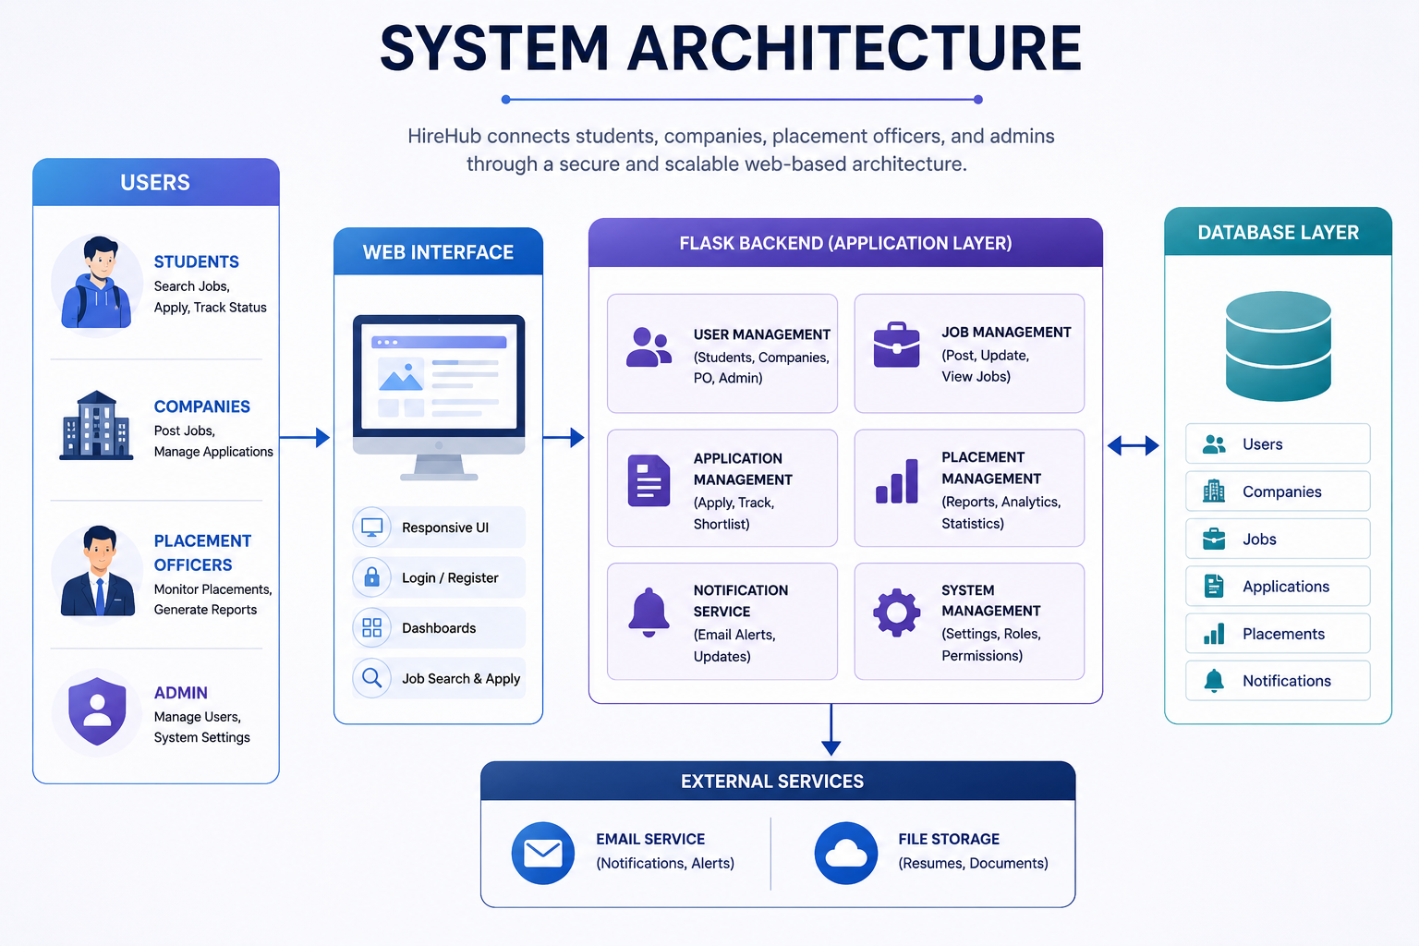

Slide 6

OBJECTIVES
To develop a centralized platform for students, companies, and placement officers.
To allow students to search and apply for suitable job opportunities.
To help companies post jobs and manage student applications.
To enable placement officers to monitor recruitment and placement activities.
To build a simple and efficient system for campus recruitment.

Slide 7
LITERATURE REVIEW
Year | Title of the Paper | Objectives | Limitations
2021 | Online Recruitment and Selection: A Review of Current Practices | Study the use of online platforms for recruitment and candidate selection. | Online recruitment may reduce direct interaction between recruiters and candidates.
2022 | E-Recruitment: A Review of Recruitment Practices and Technologies | Analyze how digital platforms improve the recruitment process for organizations. | Effectiveness depends on internet access and the quality of candidate information.
2023 | Digital Transformation of Recruitment Processes | Study how digital systems can simplify job posting, candidate management, and recruitment activities. | Implementation can require technical skills and proper system management.
2024 | Technology-Based Recruitment and Talent Acquisition | Analyze how technology helps organizations manage job applications and recruitment activities. | Data privacy and security must be carefully managed when handling candidate information.

Slide 8
DATASET
The dataset contains student, company, job, and application details.
The data is stored and managed using a centralized MySQL database.
The system uses the stored data to manage job applications and placement activities.
Student ID | Student Name | Course | Skill | Job Applied | Status
S001 | Arun | B.E CSE | Python | Software Developer | Applied
S002 | Priya | B.E CSE | Java | Web Developer | Shortlisted
S003 | Kavin | B.E IT | SQL | Database Developer | Applied
S004 | Divya | B.E CSE | JavaScript | Frontend Developer | Selected
S005 | Rahul | B.E CSE | Python | Backend Developer | Pending

Slide 9
MODULE 1: STUDENT MODULE
Task | Techniques Used | Output | Outcome
Register and manage student profile. | User authentication | Student dashboard | Easy profile management
Search and apply for suitable jobs. | Search and filtering | Available job listings | Easy job application
Track application status. | Database management | Application status | Better application tracking

Slide 10
MODULE 2: COMPANY MODULE
Task | Techniques Used | Output | Outcome
Register and manage company profile. | Authentication and validation | Company dashboard | Easy company management
Post and manage job openings. | Database management | Job listings | Simple job posting
View and manage student applications. | Search and filtering | Applicant details | Easy candidate management

Slide 11
MODULE 3: PLACEMENT OFFICER MODULE
Task | Techniques Used | Output | Outcome
Verify student and company details. | Data validation | Verified records | Reliable recruitment data
Monitor job applications and placements. | Database management | Placement dashboard | Easy placement tracking
Generate placement reports. | Data processing | Placement reports | Better recruitment monitoring

Slide 12
MODULE 4: ADMIN MODULE
Task | Techniques Used | Output | Outcome
Manage students, companies, and users. | User management | User records | Better system control
Manage jobs and application records. | Database management | Updated records | Organized system data
Monitor overall system activities. | Dashboard and reporting | Admin dashboard | Easy system monitoring

Slide 13
OUTPUT & OUTCOME
OUTPUT | OUTCOME
Student dashboard with job listings and application status. | Makes the campus recruitment process simple and organized.
Company dashboard with job postings and applicant details. | Helps students find and apply for suitable job opportunities.
Placement dashboard with placement records and reports. | Helps companies manage candidates and recruitment activities easily.
Admin dashboard for managing users and system activities. | Reduces manual work and improves overall placement management.

Slide 14
CONCLUSION
Hire Hub provides a centralized platform that connects students, companies, and placement officers to manage campus recruitment activities in one system.
The system helps students easily search for suitable job opportunities, apply for jobs, and track their application status without depending on multiple platforms.
Companies can post job openings, view student applications, and manage suitable candidates through a simple and organized recruitment process.
Placement officers can monitor student applications, company activities, and placement records, making the overall placement management easier.
Overall, Hire Hub reduces manual work and makes the campus recruitment process faster, simpler, organized, and more efficient

Slide 15

REFERENCES
Kaur, P., & Sharma, R. (2021). E-Recruitment: A Study of Online Recruitment Practices and Candidate Selection. International Journal of Human Resource Management, 12(3), 145–156.
Kumar, A., & Singh, S. (2022). Digital Transformation of Recruitment and Talent Acquisition Processes. International Journal of Management Studies, 9(2), 78–89.
Patel, M., & Shah, K. (2022). Online Job Portals and Their Impact on Recruitment Efficiency. International Journal of Computer Applications, 184(15), 25–31.
Rahman, M., & Das, P. (2023). Technology-Based Recruitment Systems for Improving Candidate and Employer Interaction. International Journal of Information Technology and Management, 8(4), 112–120.
Kumar, R., & Priya, S. (2024). Digital Platforms for Campus Recruitment and Placement Management. International Journal of Advanced Research in Computer Science, 15(2), 64–72.

